Slide 1

Q3 2021 Operations Review
Key Project Progress Updates | Select Performance Measurement & Data

Slide 2

Topic

Slide 3
Agenda & Overview
LEO
Progress Updates
KCRHA CEO starts April 26; Master Services Agreement; On track for 2022
Health through Housing 2.5 PSAs Active; 4 in Negotiation; ESHB 1070 passed
Affordable Housing Pipeline 3,855 units in pipe; ½ of Projects Delayed for $
Best Starts for Kids Renewal Ballot Measure at Council; Imp Plan Due in June
Data & Performance Measures
Medicaid-Funded Behavioral Health & KC Integrated Care Network
Designated Crisis Responders
Homelessness Crisis Response System (HMIS)
COVID-19 Isolation & Quarantine
Eviction Prevention & Rental Assistance (EPRAP)

Slide 4
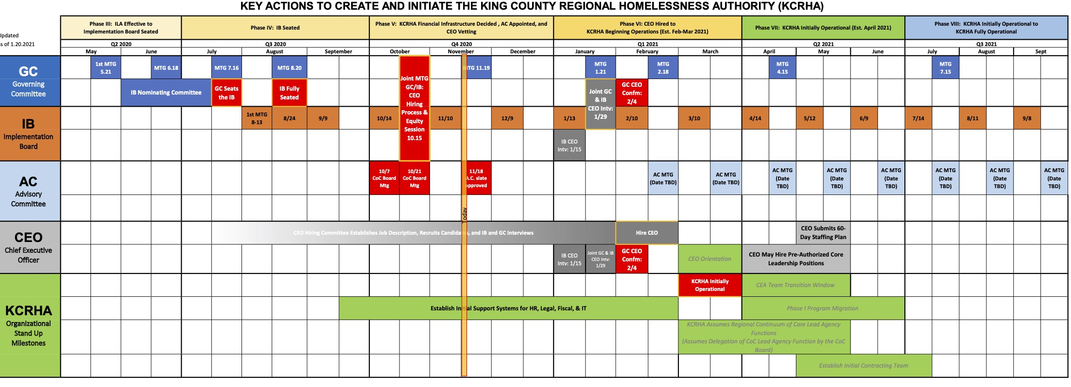
KCRHA
King County Regional Homelessness Authority
Next Steps: Onboard CEO; Facilitate Transfer of Continuum of Care; Negotiate Master Services Agreement
Initiative is DELAYED but proceeding; On-Track for initial operations by June 2022
LEO

Slide 5
HtH
Health through Housing
LEO
Pass ESHB 1070 (Enacted on April 14, 2021)
Agree With Cities to Allow KC to Engage with Hotels
Seattle (Agreed to site up to three hotels & operations for 350 PSH units)
East County
Redmond (Redmond proposed a hotel—Hotel declined to sell, IDing a new Hotel)
Kirkland (Kirkland ID’d 3 hotels, Only One Feasible, Seeking Permission for LOI)
North County
Kenmore (No Feasible Hotels)
Bothel
Shoreline
Woodinville
South County
Federal Way (Agreed to program concept, DCHS to look for hotels with HS staff from Federal Way)
Kent (City Staff returning a list of characteristics of viable hotels; Relates to disposition of Kent I/Q hotel)
Renton (City considering offer to purchase a specific hotel; no response yet)
Burien
County Implementation Plan (Due in September)
Provider RFQ
Evaluation Plan

Slide 6
LEO
COVID-19
IQ
DCHS partners with PHSKC and FMD to operate the County’s Isolation and Quarantine system for COVID-19. King County controls 4 IQ sites (Issaquah/100; Kent/79; Aurora/24; Top Hat/32). Only Issaquah and Aurora currently active. Transitioning to just Issaquah in the next 30 days. DCHS forecasts ending our IQ role in December 2021.
124 beds currently online
Includes Issaquah and Aurora
282 beds online at some point since March 2020
Includes Issaquah, Aurora, Eastgate, and Kent
3,679 total referrals since March 2020
Selected Performance Measures
# Guests Served
Race & Ethnicity and Homelessness Status of Guests
Occupancy Rate
% Guests who Complete Full I/Q Stay

Slide 7
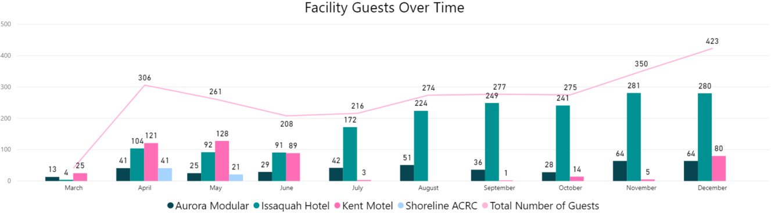
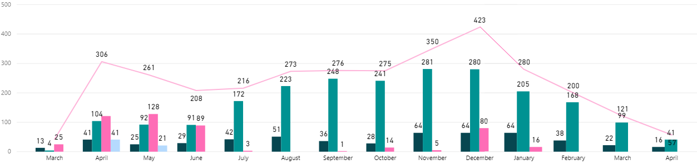
LEO
IQ
Guests Served
2,654 guests served since March 2020
*Data Source: I&Q Dynamics Database of 4/12/21

Slide 8
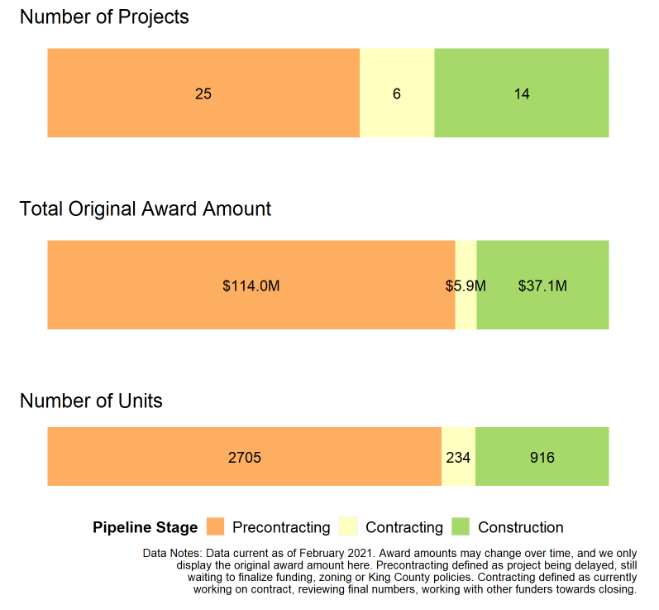
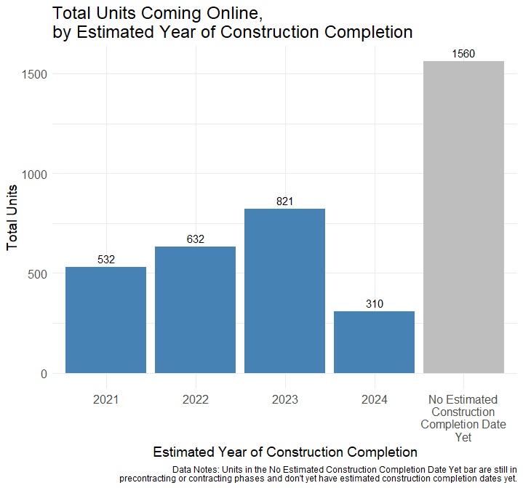
Affordable Housing Pipeline Overview
Since 2015, 21 projects completed, representing 1,227 units and $40.1M in King County funds awarded
Currently 45 projects in pipeline, representing 3,855 units and $157.0M in King County funds awarded
JESSE
Map Link (must be logged into VPN to access, and use King County login info to log into Tableau Server)

Slide 9
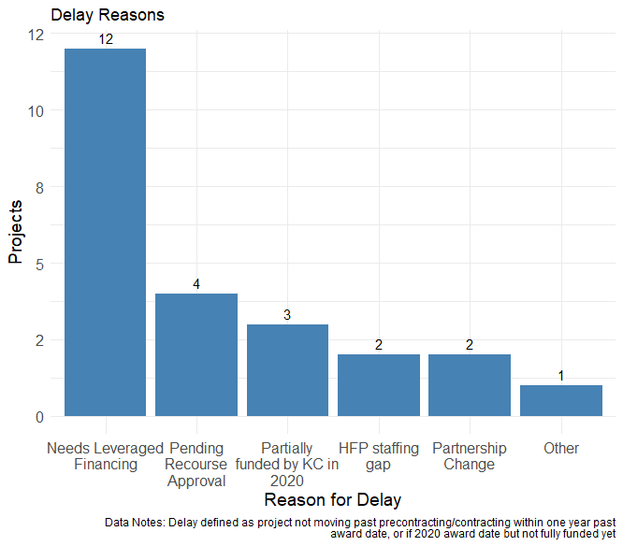
Affordable Housing Pipeline Delays
JESSE
Delays
Currently 24 projects in pipeline have delays, representing 53% of all projects.
50% of delays due to reliance on other leveraged competitive resources.
Majority of projects rely on allocations of highly competitive Low Income Housing Tax Credits.

Slide 10
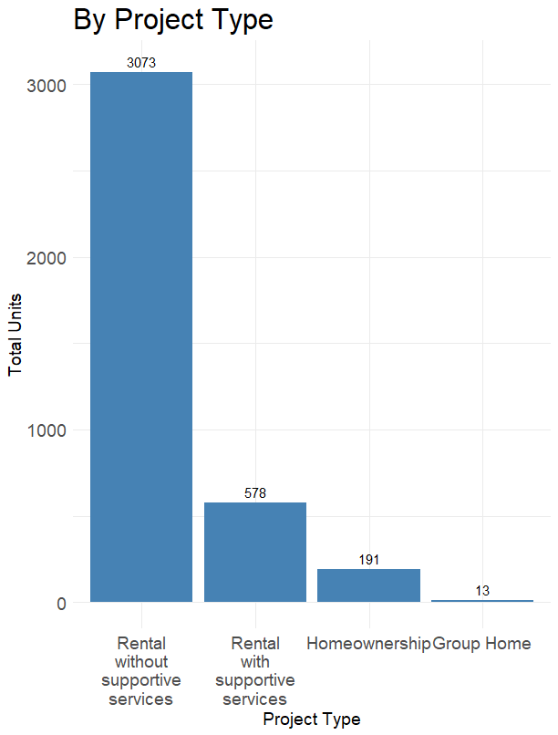
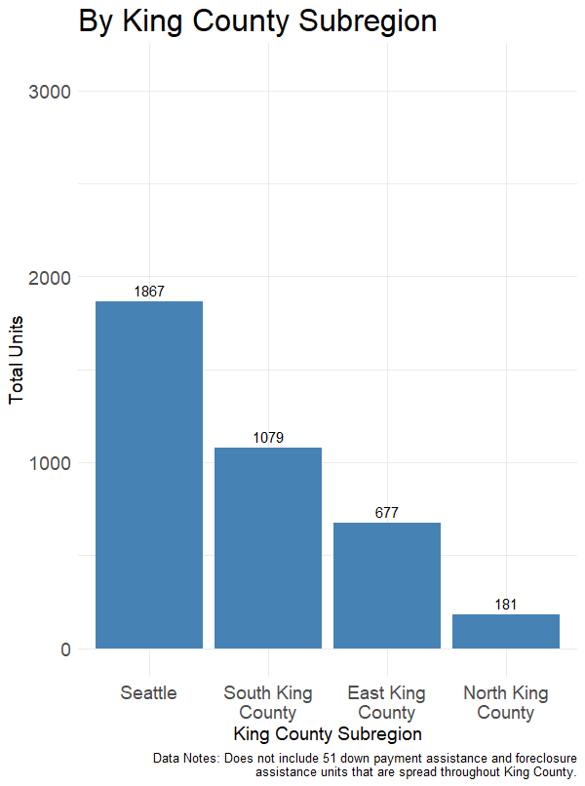
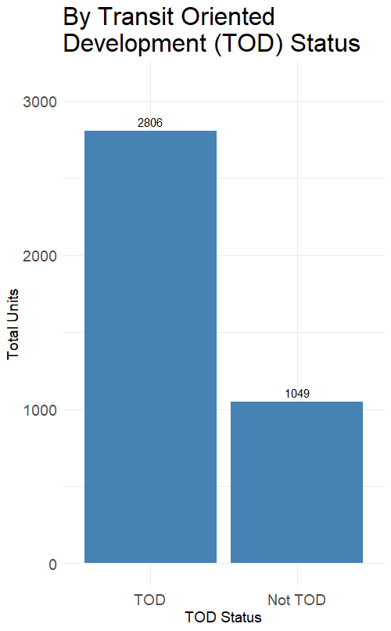
Affordable Housing Pipeline Breakdown of Units by Type
JESSE

Slide 11
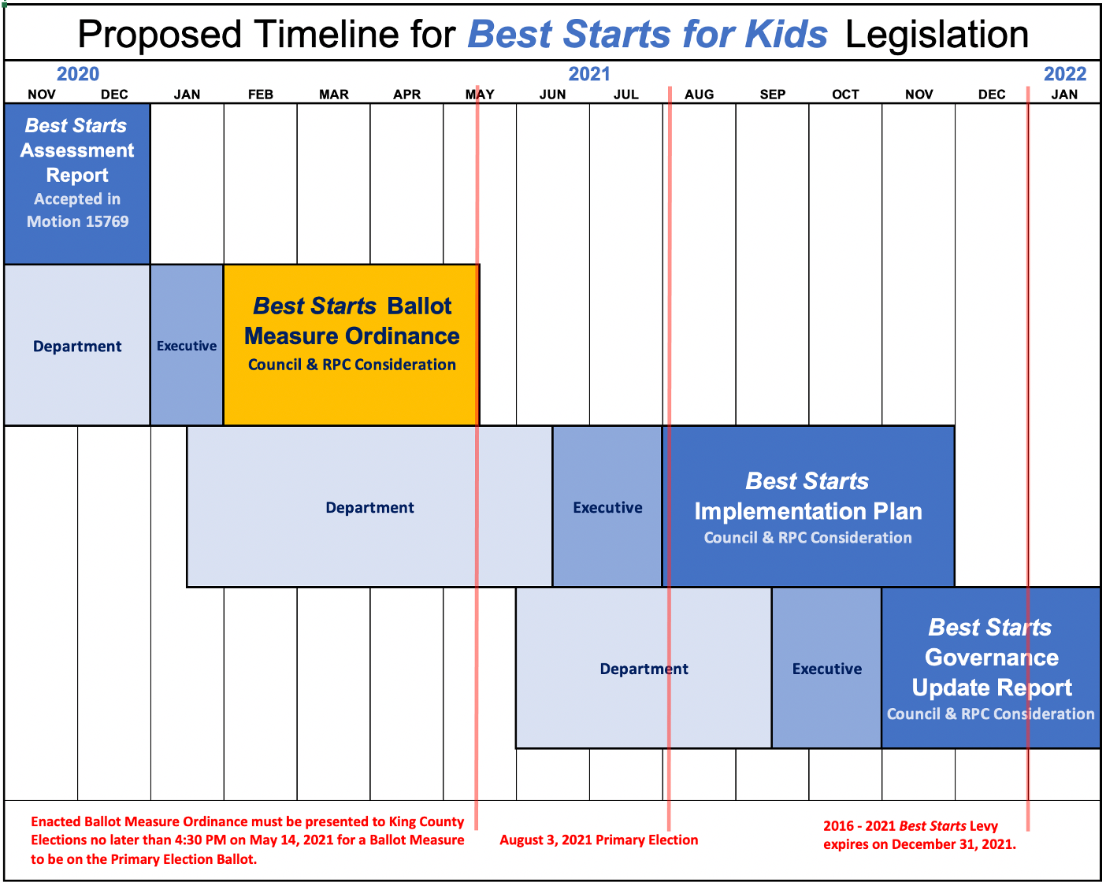
BSK
Best Starts for Kids
LEO
On Track
Ballot Measure Ordinance at Full Council this week
Implementation Plan Due to Executive in June
Governance Update Report Due to Executive in September

Slide 12
JENNIFER
EPRAP
Eviction Prevention & Rent Assistance Program
As part of the emergency response to COVID-19, DCHS began administering a rental assistance and eviction prevention program in 2020. The program has used federal, state, and local funds. DCHS recently launched EPRAP 2.0, complete with a new enterprise data system being used by 30+ partner agencies.
Selected Performance Measures
Tenant & Landlord Interest
Tenants & Landlords Selected
Tenants & Landlords Receiving Assistance
Total Assistance Provided
Time from Engagement to Assistance
% Selected Households Receiving Assistance
Average Amount of Assistance per Household

Slide 13
EPRAP
Tenant/Landlord Interest
JENNIFER
Tenant Fund | 16,409 households submitted an interest form | 12,148 households were eligible in the lottery
Small Landlord Fund | 416 landlords submitted an interest form | 1,004 households represented by these landlords
Large Landlord Fund | 368 landlords submitted an interest form | 12,409 households represented by these landlords
*Data represent unique households

Slide 14
EPRAP
Tenants/Landlords Selected
JENNIFER
Roughly 1/3 of eligible households.
Tenant Fund | 5,166 households selected in the lottery
Small Landlord Fund | 416 landlords assigned to a provider | 1,004 households represented by these landlords
Large Landlord Fund | 368 landlords assigned to a provider | 6,425 households represented by these landlords
*Data represent unique households

Slide 15
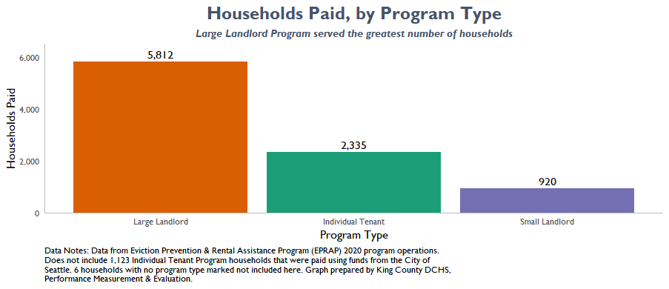
EPRAP
Tenants/Landlords Receiving Assistance
JENNIFER
Tenant Fund | 2,335 households received rental assistance
Small Landlord Fund | 920 households received rental assistance
Large Landlord Fund | 5,812 households received rental assistance

Slide 16
JENNIFER
EPRAP
Total Assistance Provided
Time from Engagement to Assistance
Tenant Fund | $10,548,343 in rental assistance distributed on behalf of tenants
Small Landlord Fund | $4,965,102 in rental assistance distributed on behalf of tenants
Large Landlord Fund | $22,063,770 in rental assistance distributed on behalf of tenants
Tenant Fund | 20% of selected households received rental assistance within two weeks
Small Landlord Fund | 61% of selected households received rental assistance within two weeks
Large Landlord Fund | 22% of selected households received rental assistance within two weeks
*Received rental assistance refers to the time from someone being referred to a provider to being paid

Slide 17
JENNIFER
EPRAP
Percent of Selected Households Receiving Assistance
77% of all households selected received rental assistance. Broken down by fund type:
Tenant Fund | 58% of selected households received rental assistance
Small Landlord Fund | 70% of selected households received rental assistance
Large Landlord Fund | 92% of selected households received rental assistance
*Data represent unique households

Slide 18
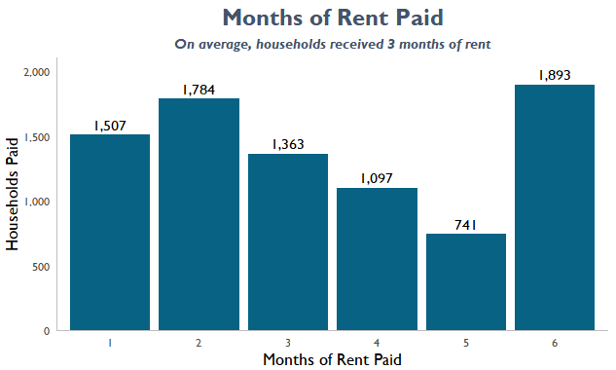
JENNIFER
Average household paid received $4,146
Average household received roughly 3 months of rent
EPRAP
Average Amount of Assistance per Household
*Data represent unique households

Slide 19
King County’s Integrated Care Network is our structure and system for administering the Medicaid-funded Behavioral Health System. The KCICN is unique within Washington State, with all other counties handing control of Medicaid Behavioral Health to private sector Managed Care Organizations (MCOs).
KCICN
Selected Performance Measures
Medicaid Eligible Individuals in King County
Open Outpatient Authorizations
% Clients w/ at least 1 Day Service in Last 90 Days
Service Hours per Episode

Slide 20
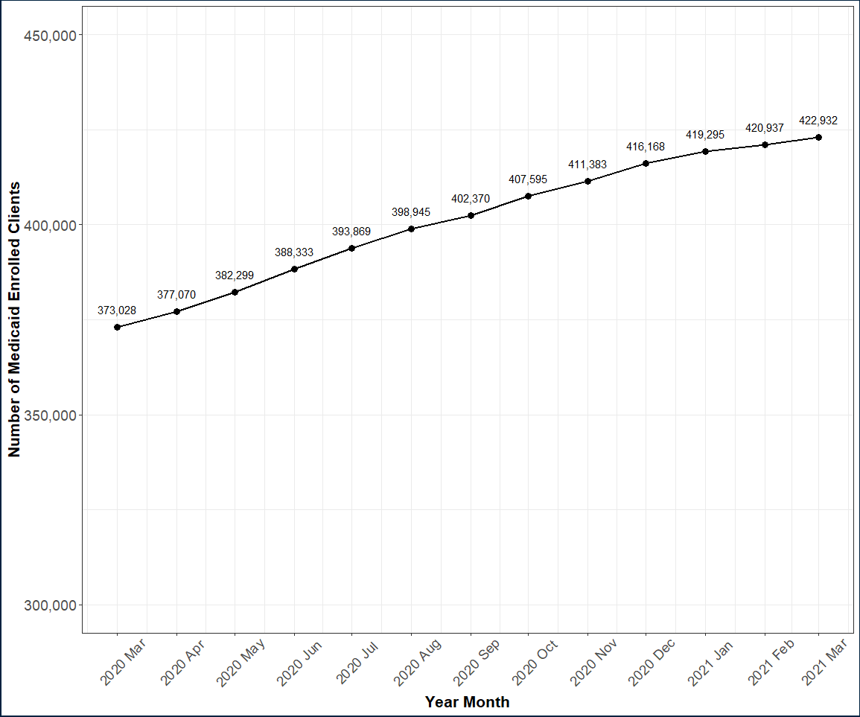
MATT
Medicaid-Eligible King County Residents
Increased by 13% from March 2020 to March 2021
Expected increase due to pandemic-related job losses that results in loss of income and employer-based health insurance

Slide 21
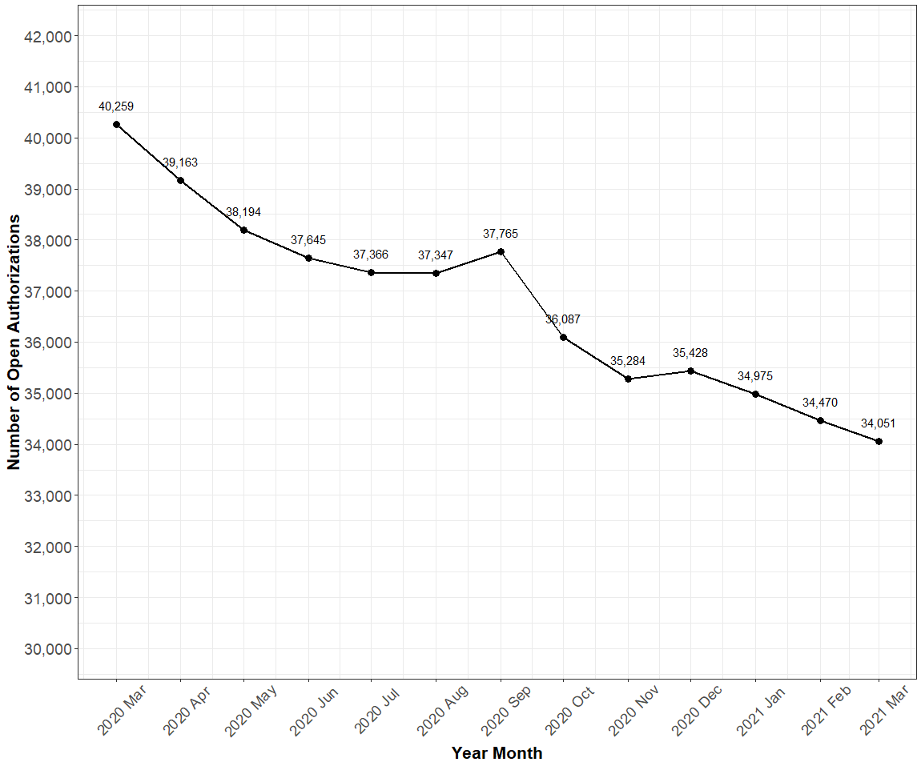
THERESA
Open Outpatient Authorizations
Declined by 15% between March 2020 and March 2021
Likely factors:
Closing authorizations in preparation for new payment model
New rule of closing authorizations with no services in 90 days
COVID related reluctance

Slide 22
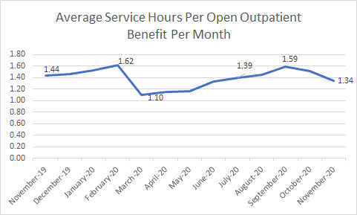
Service Hours/Open Outpatient Authorization
THERESA
DETAILS/Explanation

Slide 23
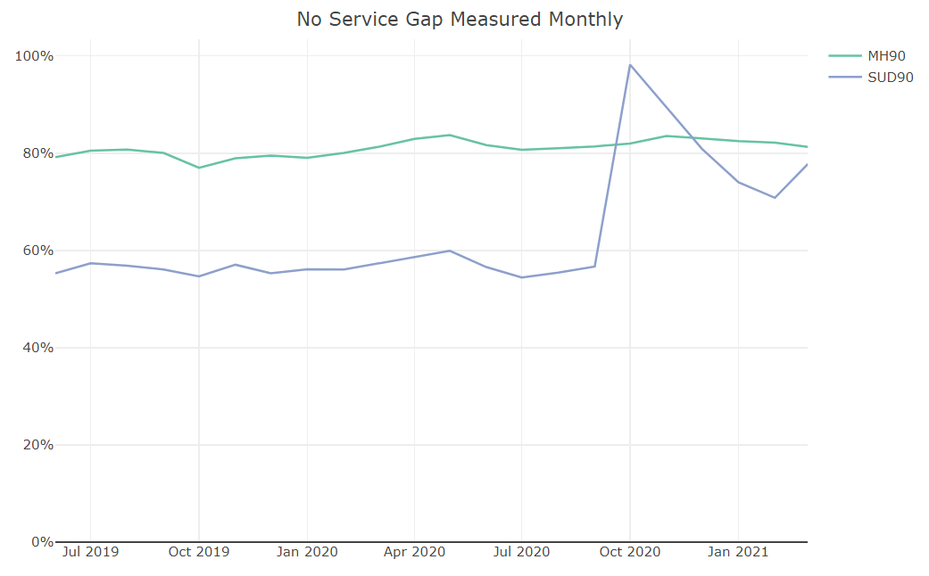
% of Clients w/ at least One Service in the last Ninety Days
THERESA
Proportion of SUD outpatient clients without a service gap increased in October 2020 due to the administrative closing of old auths in preparation for new payment model
Service gap calculation methodology was updated in 2021 to align with changes made in the outpatient payment model, resulting in the inclusion of more newly re-authorized benefits

Slide 24
DCR
Designated Crisis Responders perform a State Law-required assessment under the Involuntary Treatment Act. Persons who the DCRs determine to be a grave danger to themselves or others are detained subject to ITA Court review. DCRs respond to call outs from Hospitals and Jails on mandatory timelines and to community calls as possible.
Selected Performance Measures
Number of Referrals
Race & Ethnicity of Persons Assessed
DCR Response Times vs. Requirements
Percentage Detentions/Assessments

Slide 25
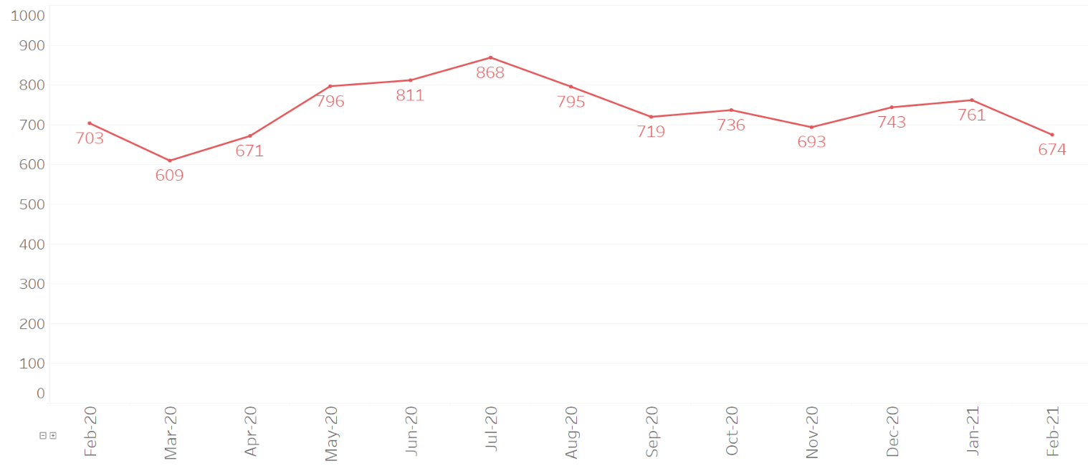
# of DCR Referrals
MINH
Source: Crisis System and SUD Residential Monitoring Dashboard

Slide 26
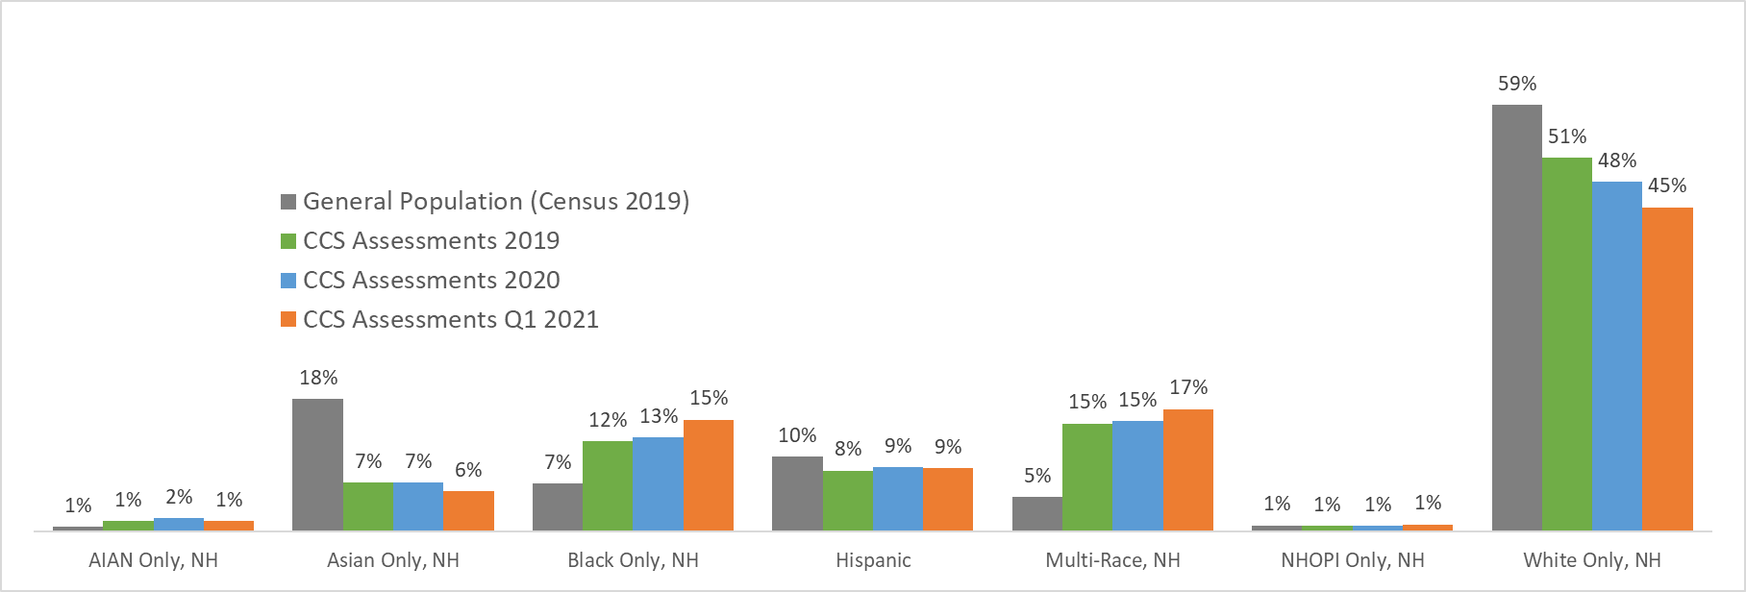
MINH
DCR Assessments by Race & Ethnicity
*NH=Not Hispanic, NHOPI=Native Hawaiian or Other Pacific Islander, AIAN=American Indian and Alaska Native
Source: 2019 Census data from OFM and DOH’s Census Tracts
CCS data from the King County Behavioral Health Information System

Slide 27
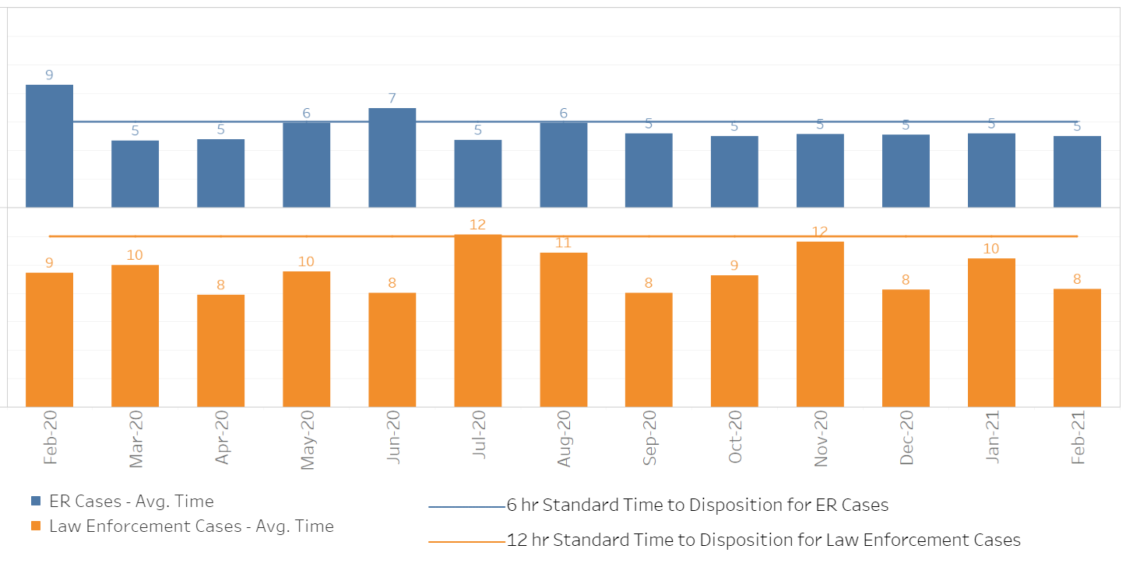
MINH
DCR Actual Response Times vs. Standards
Source: Crisis System and SUD Residential Monitoring Dashboard

Slide 28
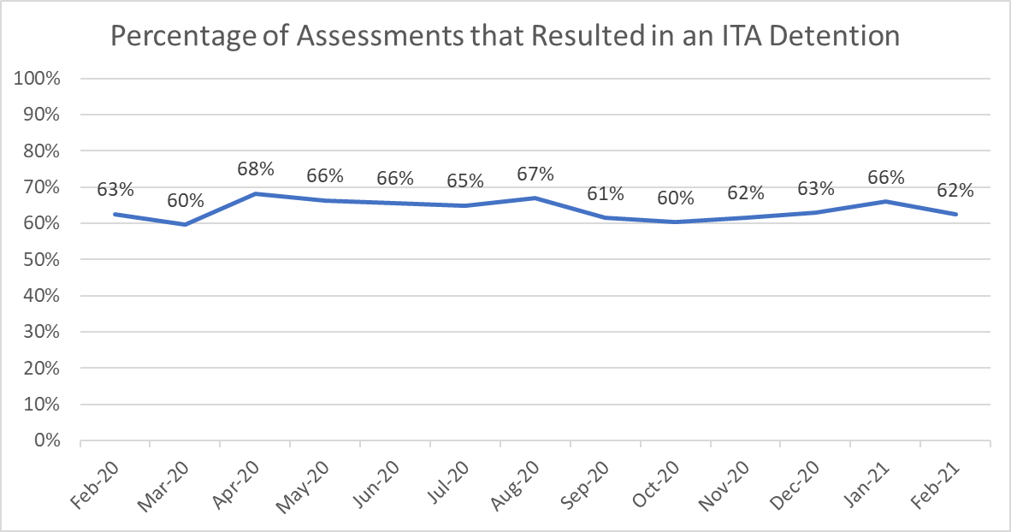
MINH
% DCR Assessments that lead to Detention
The proportion of individuals assessed for involuntary detention who were detained has remained relatively stable
Detention rate remained at higher than normal from April through August last year and had a peak around January this year
Source: Crisis System and SUD Residential Monitoring Dashboard

Slide 29
HMIS
Data from the Homeless Management Information System provide insight into who is utilizing homelessness services in King County. HMIS is a measurement of who uses the portion of the overall system that enters data into the system. It does not include households that are not receiving services or using non-affiliated services.
HMIS data are available for public review, including levels of analysis beyond the scope of this Operations Review: https://regionalhomelesssystem.org/regional-homelessness-data/
Selected Performance Measures
System Entries and Exits
Active Households
Length of Stay
Literally Homeless Entries
Utilization Rate
Exits to Permanent Housing
Returns to Homelessness

Slide 30
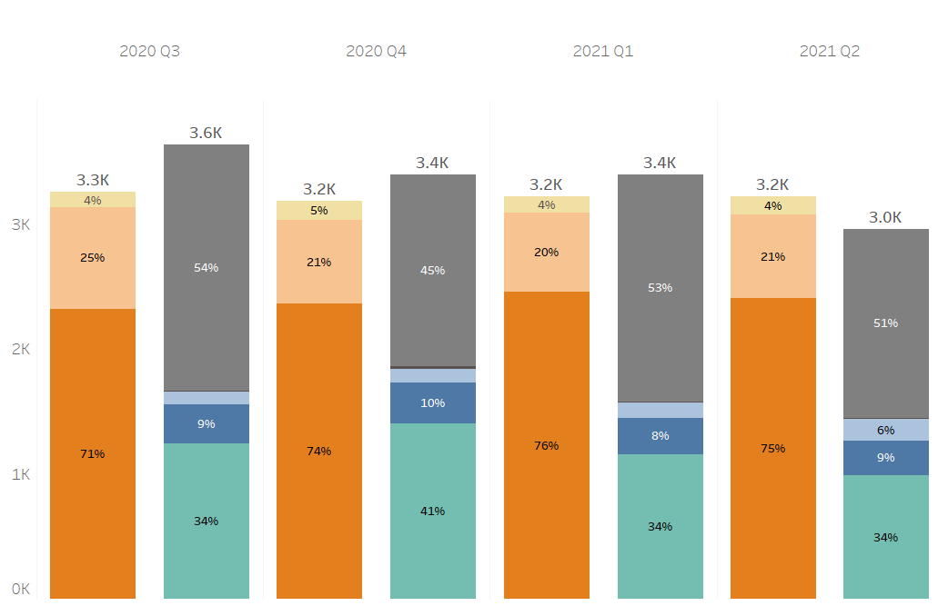
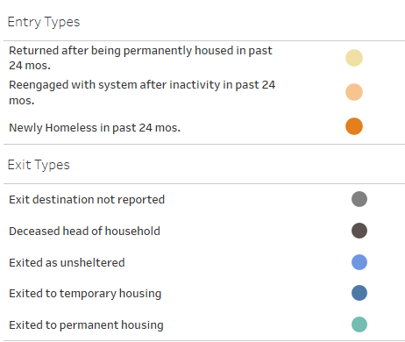
HMIS
Entries & Exits
Source: Data includes households experiencing homelessness and receiving services as captured in the Homeless Management Information System (HMIS) as of 07/01/2021. Results are subject to change as data are continuously collected in HMIS.
Note, a single household can experience more than one episode of homelessness -- an entry and exit from the system -- per year.

Slide 31
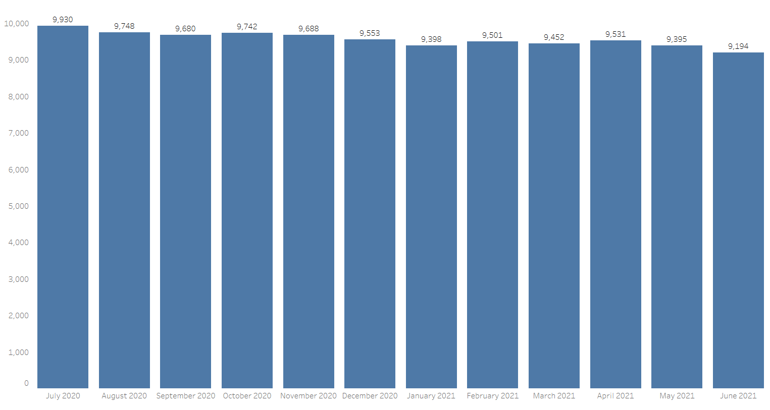
HMIS
Active Households
The number of households experiencing homelessness and receiving services in the homeless response system continues to steadily decline and be below pre-pandemic levels.
Source: Data includes households experiencing homelessness and accessing services as captured in the Homeless Management Information System (HMIS) as of 7/1/2021. Results are subject to change as data are continuously collected in HMIS.

Slide 32
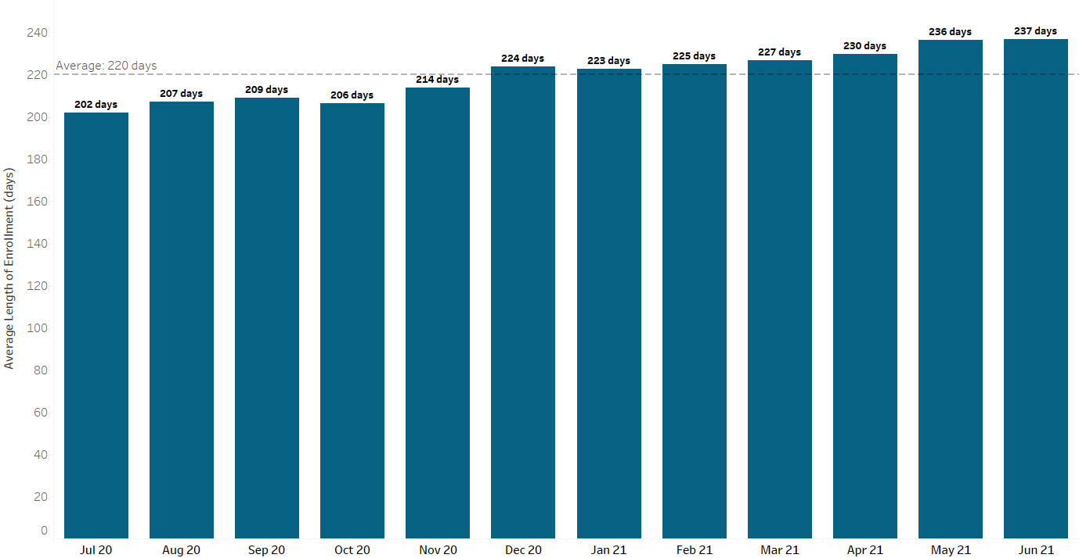
HMIS
Length of Stay
Lengths of stay has continued to steadily increase over time.
Lengths of stay for emergency shelters, transitional housing, and rapid-rehousing programs.
Source: Data includes households experiencing homelessness and accessing services as captured in the Homeless Management Information System (HMIS) as of 7/1/2021. Results are subject to change as data are continuously collected in HMIS.

Slide 33
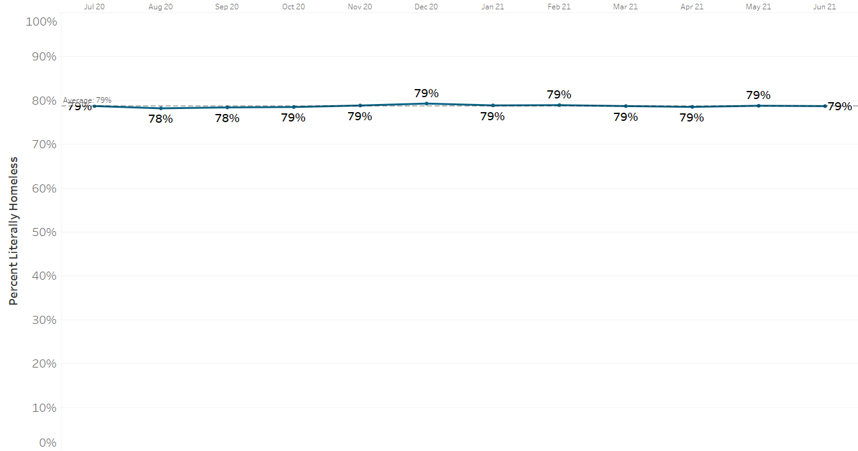
HMIS
Literally Homeless Entries
Homeless entries remain at average levels.
Homeless entries for emergency shelters, transitional housing, rapid-rehousing and permanent supportive housing programs.
Source: Data includes households experiencing homelessness and accessing services as captured in the Homeless Management Information System (HMIS) as of 7/1/2021. Results are subject to change as data are continuously collected in HMIS.

Slide 34
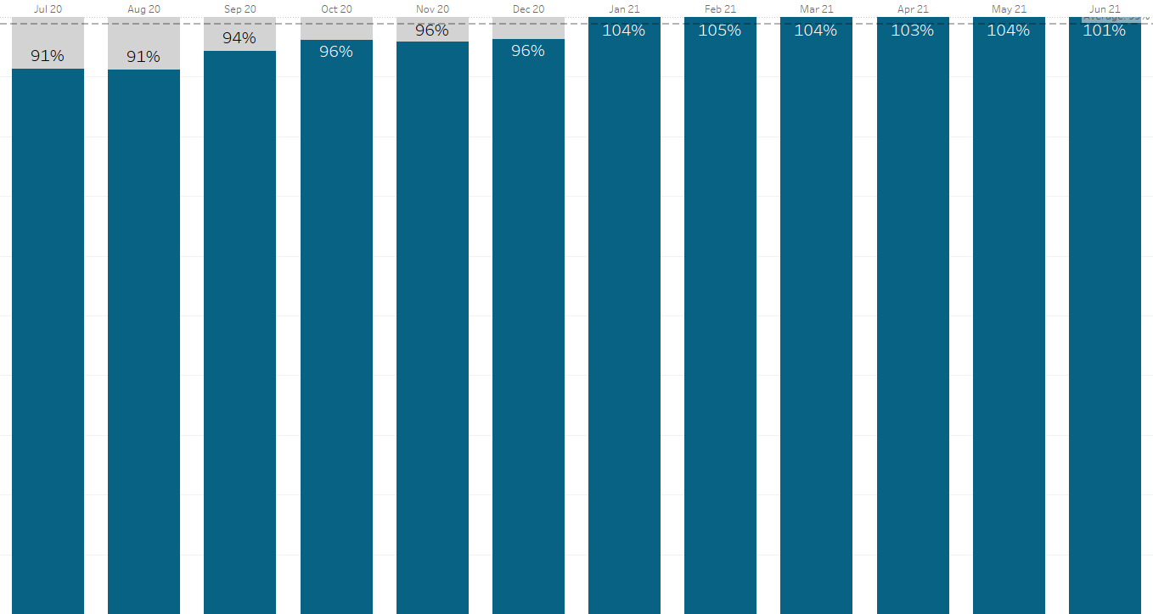
HMIS
Utilization Rate
Overall utilization rates has increased going into 2021
Utilization rates for emergency shelters, transitional housing, and permanent supportive housing programs.
Source: Data includes households experiencing homelessness and accessing services as captured in the Homeless Management Information System (HMIS) as of 7/1/2021. Results are subject to change as data are continuously collected in HMIS.

Slide 35
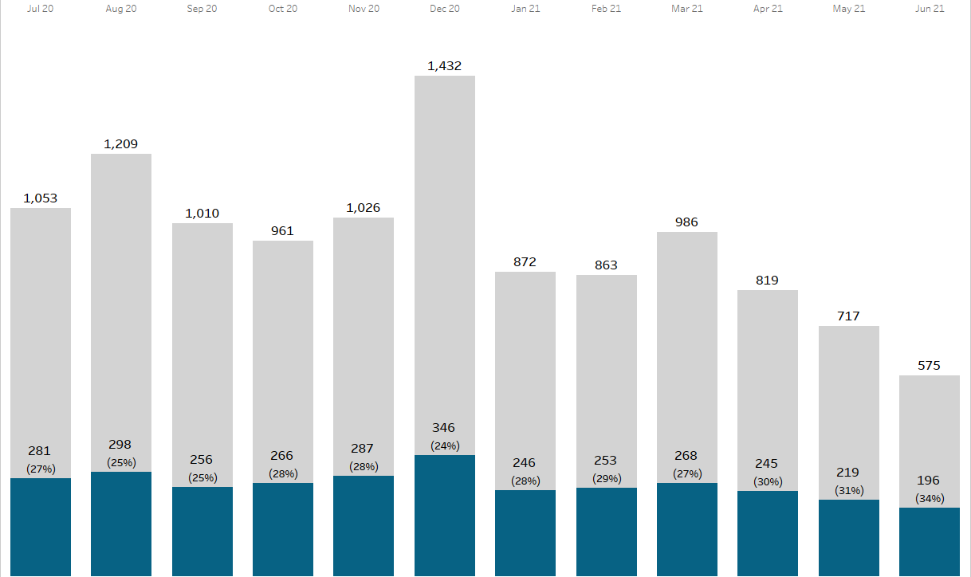
HMIS
Exits to Permanent Housing
The proportion of households exiting to permanent housing has steadily increased in part because the total number of those leaving programs has steadily declined following the onset of the pandemic. The number of households leaving programs continues to be below pre-pandemic levels (approx. 1,000 exits/month fewer).
Exits to permanent housing for emergency shelters, transitional housing, and rapid-rehousing programs.
Source: Data includes households experiencing homelessness and accessing services as captured in the Homeless Management Information System (HMIS) as of 7/1/2021. Results are subject to change as data are continuously collected in HMIS.

Slide 36
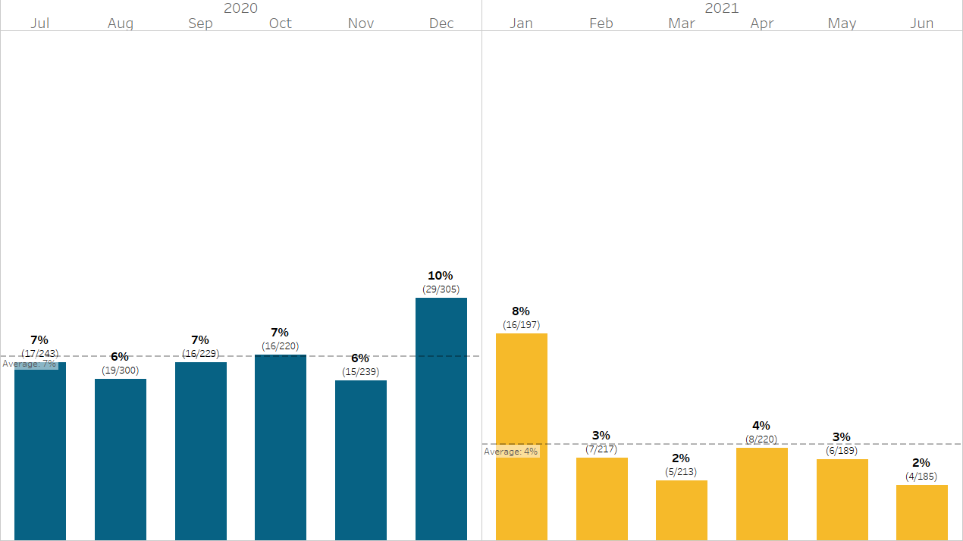
HMIS
Returns to Homelessness
The proportion of households that exited to permanent housing and returned to homelessness within 6 months declined from the last half of 2020 (7%) to the first half of 2021 (4%).
Returns for emergency shelters, transitional housing, rapid-rehousing, and permanent supportive housing programs.
Source: Data includes households experiencing homelessness and accessing services as captured in the Homeless Management Information System (HMIS) as of 7/1/2021. Results are subject to change as data are continuously collected in HMIS.

Slide 37
Questions & Guidance

